Slide 1
Ideas for Social Projects
As of 2012

Slide 2
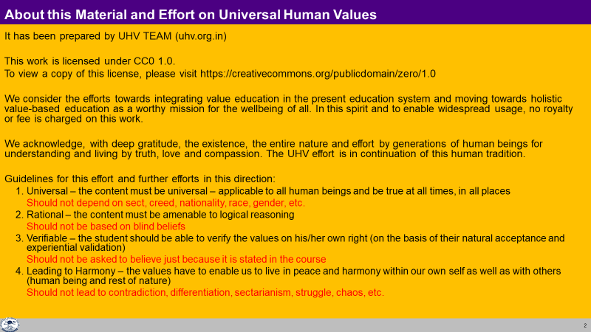

Slide 3
Information (as of 2012)
Teacher’s Orientation Program (8-Day Workshop)
21-28 Dec IIIT Hyderabad English
30 Dec – 6 Jan Punjab Hindi
27 Jan – 2 Feb Galgotias, Gr. Noida Hindi
19-26 April GCBS Gedu, Bhutan (RUB) English
Contacts:
IIIT Hyderabad
Surya Bhagawan 99480 10253, humanvalues@iiit.ac.in
Uttar Pradesh Technical University
Bhanu Pratap Singh 98894 98839, pratap_cse@rediffmail.com
Sateesh Awasthi 98680 10352, hvpemtu@gmail.com
Punjab Technical University, Jalandhar
Jagmeet Bawa 94780 98071, ptuehv@gmail.com
Jitender Narula 94780 98082, ptuehv@gmail.com
Royal University of Bhutan
Director, Lhato Jamba +975 1764 5167, lhatoj@gmail.com
Himachal Pradesh Technical University, Hamirpur
Parminder Singh Gill 94184 54496, doshptu@gmail.com
Rajul Asthana 98490 94285, rajul.asthana@yahoo.com
Shyam Kumar 94503 42998, shyamk@iitk.ac.in

Slide 4
Resources for self-study & sharing
Syllabus
Teachers Manual (Lecture Plan 28 Lectures & 14 Practice Sessions)
Text Book
Posters
Presentations, including Practice Sessions, Tutorials & Videos
Video of Workshop Lectures (Lecture-by-Lecture)
Weekly Meeting
Web Site
8-Day Teachers' Orientation Program
How to Share Values
Examination & Evaluation
Social Projects & Social Internship
Process of Implementation (stage by stage)
Advanced Study
PSL2 …

Slide 5
How to Share Values
The role of the teacher is that of a facilitator – to facilitate the student to explore on their own right so that it leads to self-exploration…understanding
With this intention the teacher’s role is:
  To develop an environment of trust… affection… guidance at home, in the class, department, college …
  To place the proposals of what is right before the students
  To draw their attention toward each proposal and to give enough time & opportunity to explore, verify, accept, validate on their own right (focus on self-exploration & right proposals vs person/book)
  To respond with responsibility to the questions, or clarifications sought by the students in this process

Slide 6
Environment
College Value Education Cell (keep in touch with University Value Education Cell)
Weekly Meeting
Short Workshops
Socially Relevant Projects

Slide 7
Examination & Evaluation
An Understanding of Human Values
Clarity on the Program for Value Based Living
Character (Charitra) –
  Compassionate behaviour and work (Dayapurna Karya Vyawahar):
  Access to rightfully acquired wealth (Swa-dhan)
  Chastity in conjugal relationship (Swa-purush/Swa-nari)
      Behaviour – Mutually fulfilling relationship with all human beings, ensuring Justice (Nyaya), ie. the student makes progress in living in accordance with universal human values
      Work – Mutually enriching relationship with rest-of-nature, ensuring Prosperity (Samriddhi) in his family as well as Suraksha of rest-of-Nature. This means the student makes progress in taking the responsibility for right utilization, protection and enrichment of all the assets including the Self (I), the Body as well as physical facilities
      Participation in Human Order that facilitates achievement of the 4 Human Goals. i.e. Right Understanding in every Human Being, Prosperity in every family, Fearlessness (Trust) in society and Co-existence with Nature/Existence by participating in Education-Sanskar, Health-Sanyam, Justice-Suraksha, Production-Work and Storage-Exchange (Vyavastha ke panchon ayam mein bhagidari – jo 4 manav lakshya ko pura karne mein sahyogi ho)

Slide 8
For now (Session 2011-12) evaluation of the student for the Human Values and Professional Ethics course is to be done in 3 dimensions:
Information absorbed from the course content/Syllabus To be evaluated through exam paper. Some weightage may be given for attendance
Understanding developed by Self Exploration and Self Verification on the basis of one's Natural Acceptance. To be shared by student in their own words and discussed with teacher
Events that reflect the understanding, above. These could be examples of behavior, work or participation in society. To be shared by student in their own words and discussed with teacher
For the session 2011-12, the above 3 dimensions are to be evaluated both in internal as well as external examination as follows:
External End-semester Evaluation (60%)
  There will be only ONE question paper for all the three languages viz. Punjabi, Hindi & English.
    Definitions/descriptions provided in syllabus
    Students’ understanding to be expressed in their own words
    Students’ understanding applied to some scenarios/events
    (Sample question papers are attached)
Internal Evaluation (40%)
  Class Tests totalling 24 marks (2 MSTs of 12 marks)
  Viva totalling 11 marks
  Attendance 5 marks

Slide 9
Class Tests totalling 24 marks (2 MSTs of 12 marks)
Viva totalling 11 marks
Attendance 5 marks

Slide 10
Social Projects, Internship & Socially Relevant 4th Year Projects
The teachers & students can develop a ‘holistic perspective’ where they are able to visualize a life of social-participation and connectedness with the family, society as well as environment/nature (a shift from self-centeredness).
Through projects & internship, they can experience people who are making effort in this direction; are living-examples, particularly in their family, in their village and in the state.
Relevant data can be collected, collated and understood; and a wholesome way of living can become clear; this would be another step toward a humane society.
Facilitating teachers & students to develop their understanding is the focus of these projects and activities.

Slide 11
Practical & Socially Relevant Projects / Internship
Human science & technology is one that facilitates clarity on human goal & fulfillment of human goal in one or more of the 5 dimensions:
  Education–Sanskar
  Health–Sanyam
  Production–Work
  Justice–Suraksha
  Exchange–Storage
And one can see directly the connectedness to one or more of the human goals:
  Right Understanding in every human being
  Prosperity in every family
  Fearlessness (Trust) in society and
  Co-existence with Nature/in Existence

Slide 12
Practical & Socially Relevant Projects / Internship
understanding/realization
feeling/thought
behaviour with human beings and
work with rest-of-nature
Priority
right understanding in the self
relationship with other human-beings as well as
physical facilities with rest-of-nature

Slide 13
Practical & Socially Relevant Project
Whatever project or activity is taken up, it must reinforce right understanding. With this clarity we can select projects and activities. e.g. Tree Plantation:
Understanding that human being can live with the rest of the nature in a mutually fulfilling manner
Our participation (bhagidari) in this Existence includes ensuring Enrichment, Protection and Right Utilization of rest of the nature. So, we need to ensure that we rightly utilize the products from the trees, like fruit, vegetables, wood etc. We also need to ensure that we are protecting and nurturing the trees that we have planted and have not damaged existing trees while planting the new ones
If we pay attention to all these points then it means that tree plantation helps us in developing our understanding
If we are doing tree plantation just to get respect, press coverage, tick mark on an activity sheet etc. then it means that we have not understood (the main point), and such a project would not be worth doing

Slide 14
Practical & Socially Relevant Projects / Internship
In the absence of this clarity of human goal, most of the time & effort is spent on accumulation of physical facilities- that too in just a few individuals, leading to mistrust between people as well as resource depletion and pollution in rest-of-nature.
We do not suggest that one delve into the details of problems or exclusively finding out “what is happening”.
A detailed study of the current state can be helpful (what not to do) if there is clarity on human goal (what to do) and some direction for “what to do” and a project (action) for it is the bulk of the effort with your role in it clearly visible

Slide 15
1/ Projects in dimension 1-education-sanskar
The role of education is to facilitate the development of the competence to live with Definite Human Conduct by ensuring all 3 (Right Understanding, Relationships and Physical Facilities) – in every Human Being.
Education = Developing Right Understanding.
Sanskar = Commitment/ Preparation/ Practice for Right Living. Preparation includes Learning Right Skills & Technology.
Visit Riarki College (or watch the video). Share your observations on the method “each one teach one”. Further, you can share your observations on the impact on the local community (dimension 1-education-sanskar, type 1-study)
Read one chapter of a school (class 7-12) maths or science textbook. Relate this chapter to real life. E.g. the concept of inertia or LCM-HCF, integration-differentiation etc. (dimension 1-education-sanskar, type 2-model/prototype)
Run an evening class on a topic like mathematics, science or human values for the local community (dimension 1-education-sanskar, type 2-model/prototype)
Make a simple video using your cell-phone about a social issue like ‘how preconditioning is transferred in the society’ an example of which is “Ignored Truth (example of video students can make).FLV”. (dimension 1-education-sanskar, type 1-study)

Slide 16
2/ Projects in dimension 2-health-sanyam
Health-sanyam is to ensure health by appropriate ahar-vihar, shram-vyavam, asan-pranayam, aushadhi-chikitsa.
  Sanyam – Feeling of responsibility for Nurturing, Protecting and Right Utilization of the Body
  Health – the body is in order & acts according to the self.
Find out the quality of air and water in your village and in your house. What needs to be done so that the buildings in your village are eco-friendly? village (dimension 2-health-sanyam, type 1-study)
Study the awareness about Health-Sanyam in your family/community/village (dimension 2-health-sanyam, type 1-study)
Study the underlying assumptions in Ayurveda, Naturopathy, Homeopathy and Allopathy. Articulate your opinion (dimension 2-health-sanyam, type 1-study)

Slide 17
3/ Projects in dimension 3-production-work
Work – is the effort a human being does on the rest of nature.
Production – are the things obtained from work.
The important points about production-work are
  what to produce – necessary physical facility – for nurturing, protecting and right utilisation of the body
  how to produce – by Avartansheel process – a process that is cyclic as well as mutually enriching
  ensuring justice for the people involved in production
Find out how much food is cooked, consumed, wasted per day in your hostel mess. Suggest ways to facilitate responsibility in food consumption (dimension 3-production-work, type 1-study)
Make your campus self-sufficient on renewable energy using biogas, night soil, gassifier, solar power, wind power etc. (dimension 3-production-work, type 3-implementation)
Find out about power generation from rice husk & similar ‘waste’ material. Is this system avartansheel? What changes are needed to make it avartansheel? (dimension 3-production-work, type 1-study)
Develop a prototype of a pedal driven generator (dimension 3-production-work, type 2-model/prototype)
Survey your village using the CDP Survey form. Share your observations (dimension 3-production-work, type 1-study)

Slide 18
Example of a Study Project in dimension 3-production-work
Find out the quantity of food-grain (rice, wheat, corn, jowar etc.) that your family consumes annually. Taking this as the base, find out the total requirement of food-grain for your country. Find out the total production of food-grain in your country. Is the production sufficient? Articulate your conclusions.
Total Population = 113 crore
Total Production = 23000 crore kg
If Total Requirement is 100 kg/year/person, then the total requirement is 11300 crore kg/year (which is an over-estimate as we have not taken the average age. Small children need less, older people also need less).
Conclusions: Food-grain available in India is more than 2 times the need. The problem is not of food-grain production or over-population, it is of mindset, of wrong assumptions, lack of feeling of relationship and, at the core, lack of right understanding.
A full 30-page report (1-Food Assignment.pdf) is attached as a sample report.

Slide 19
Example of a Prototype Project in dimension 3-production-work
Sterling Engine (http://www.youtube.com/watch?v=7Q4UENGN_Yk)
Pune (http://www.youtube.com/watch?v=bwimXHIdx-E)
Pilani (http://www.youtube.com/watch?v=W1-1fdIKFu8)
Anil Gupta TedX talk re. Honeybee Network https://www.ted.com/talks/anil_gupta_india_s_hidden_hotbeds_of_invention

Slide 20
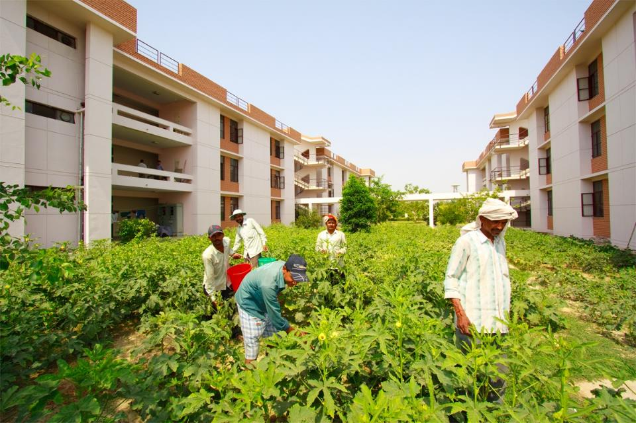
Example of a Prototype Project in dimension 3-production-work

Slide 21
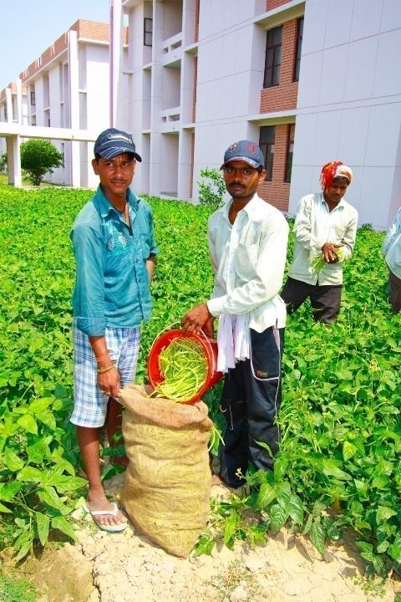
Vegetable Garden Model
Aim: To understand Avartansheel process & experience it by growing vegetables (used for Hall 8 residents)
Vegetable farming was started in Hall 8 in the month of September, 2010 as a Hall activity owned by the Hall Environment Committee (HEC)
...Approx. one quintal each of bhindi and beans was harvested every week along with brinjals, tomato, cabbage… in April 2011

Slide 22
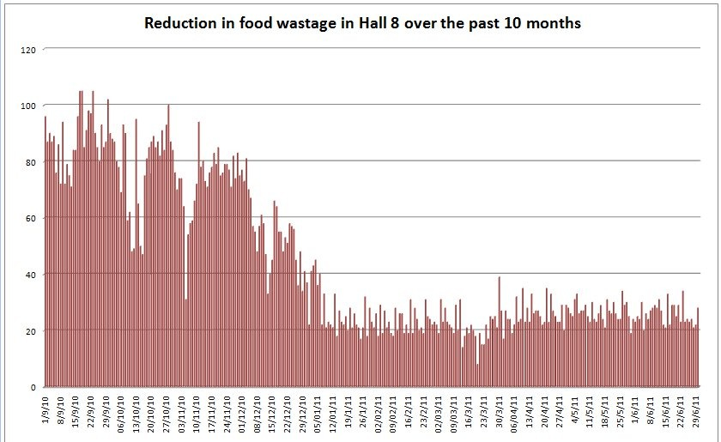

Slide 23
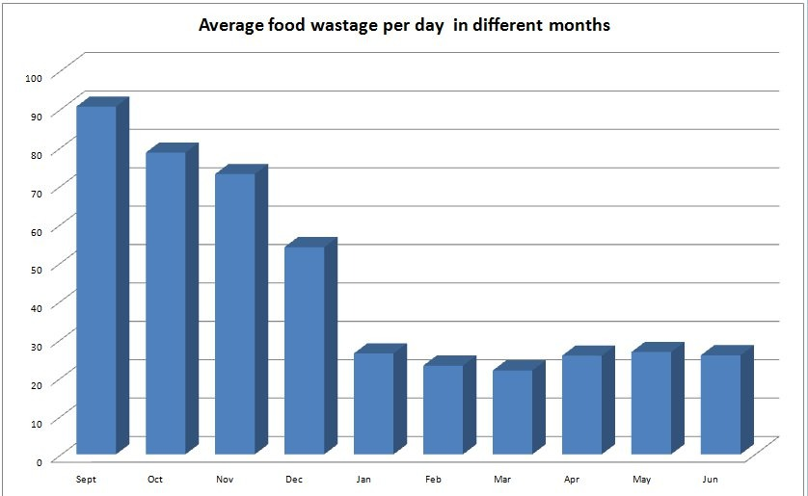

Slide 24
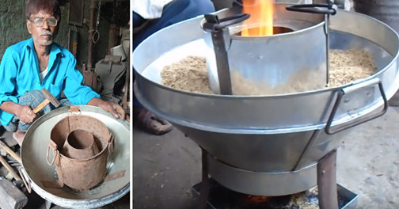
Innovations are all around – look for them!
बिहार: धान की भूसी से पक रहा है खाना, 7वीं पास के इनोवेशन ने किया कमाल!

Slide 25
https://hindi.thebetterindia.com/22239/innovation-bihar-man-invents-paddy-husk-stove-which-is-portable-and-smokeless/?utm_source=facebook&utm_medium=link&utm_campaign=innovation-bihar-man-invents-paddy-+17+oct&utm_term=fresh&utm_content=nisha&fbclid=IwAR3b9ipO3j7qEjy2y-pwi7eTgeUzigZ32pn7oKE83a6yA1Lujo9m9PUj0xo

Slide 26
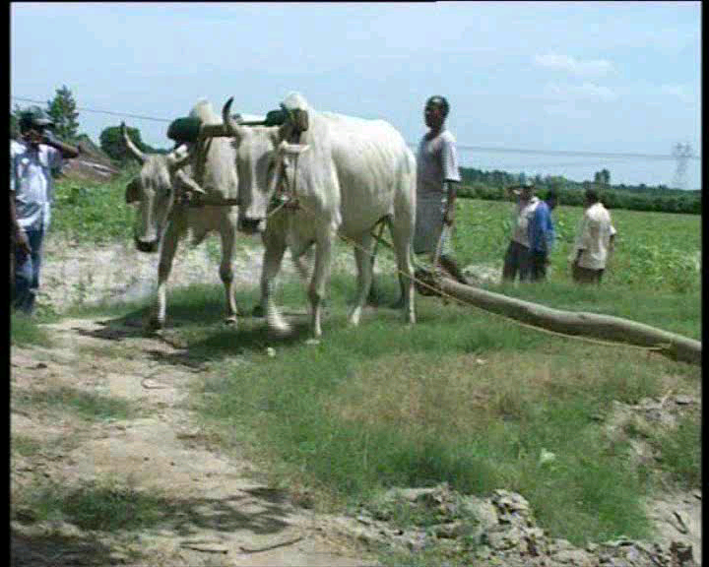
Example of a Study Project in dimension 3-production-work
This is an example of using bullocks to power farm implements
All requirements of ploughing, irrigation and threshing for 5-6 acres can be met by 2 bullocks working 6-8 hours/day
Examples in this case study:
  Pumping Water
  Cutting Fodder

Slide 27
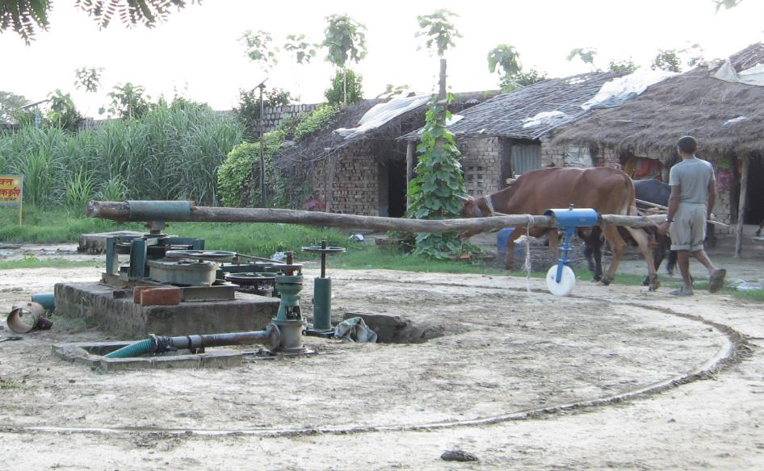
Example of a Study Project in dimension 3-production-work
Lever Holder
Wooden Lever
Bullock
Gear Box
Water Discharge
Water Pump
Wheel Arrangement

Slide 28
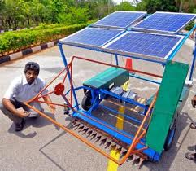
Example of a Study Project in dimension 3-production-work
Solar Powered Harvester
IIIT Hyderabad
Power requirement is
less than 10% of conventional
harvester for equivalent work
output

Slide 29
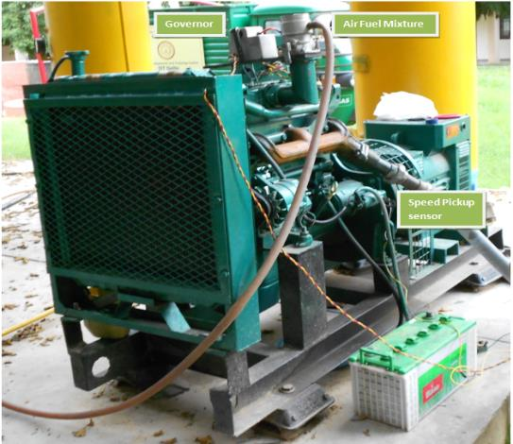
Example of a Study Project in dimension 3-production-work
Kit for Converting Existing Diesel Engine into 100% Biogas Engine
IIT Delhi in collaboration with M/s Govil Energy Solutions, New Delhi
Conversion from old
automotive engines or
old/new diesel genset
engines,
with 50% derating
100% Biogas gen-set with
electronic governing and ,
electronic ignition system
Power output range: 10-25 kW
Note: For smaller single cylinder Diesel Engines, the conversion kits were developed earlier and are already in use

Slide 30
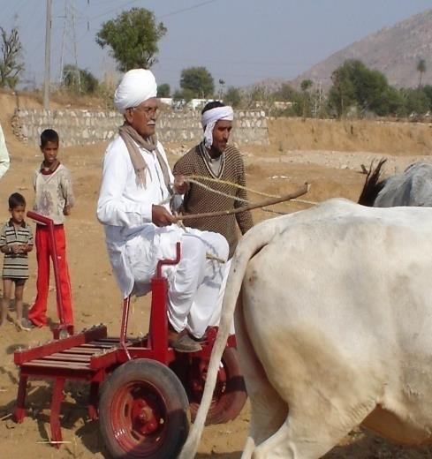
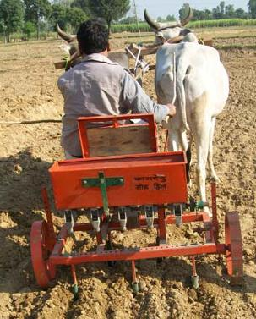
Example of a Study Project in dimension 3-production-work
Bullock driven tractor by Bhartiya Cattle Resource Development Foundation, Delhi

Slide 31
Example of a Study Project in dimension 3-production-work
Go and meet the man who planted coconut & palm trees in his village

Slide 32
Example of a Study Project in dimension 3-production-work
See the video Rainwater-Rice on the roof (http://www.youtube.com/watch?v=xeE-BzCr8Gs) & share your observations. (dimension 3-production-work, type 1-study)
For more ideas, see http://kscst.org.in/rwh.html (web site of Karnataka State Council for Science & Technology)

Slide 33
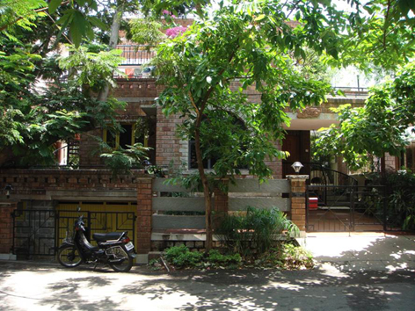
Example of a Study Project in dimension 3-production-work
"Sourabha" is located in southwestern part of Bangalore (Vijayanagar). Plot area is 2400 Sq. ft. (40 ft. x 60 ft.)
Constructed 1995
Entirely dependent on rainwater for all its needs since 1994
(including construction)
No Corporation or BWSSB water connection ever
Rainfall ~1000 mm/year
Collection ~2,23,000 lts/year
Need ~1,80,000 lts/year
Recharges Ground Water
http://kscst.org.in/rwh_files/rwh_sourabha.html

Slide 34
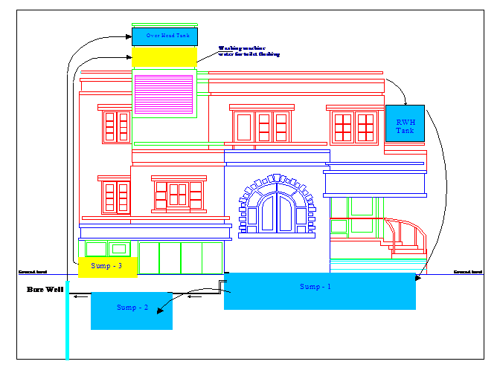

Slide 35
4/ Projects in dimension 4-justice-suraksha
Justice – Recognition of Human-Human Relationship, its fulfillment and evaluation leading to Mutual Happiness. We want to ensure Justice from family to world family.
Suraksha – Recognition of Human-Nature Relationship, its Fulfillment leading to Mutual Prosperity. i.e. prosperity in human being and suraksha (enrichment, protection & right utilization) of rest-of-nature. The immediate & fundamental issue here is right utilization. We want to ensure this from family order to world family order.
Plan and try out a 'RED CARPET SOCIETY', the 'opposite' of ragging in your hostel. The students of this society will proactively set out to help the new students settle in and be comfortable in every way at the beginning of an academic session (dimension 4-justice-suraksha, type 2-model/prototype)
Find out if your family has sufficient physical facilities. Is your family prosperous or deprived? Discuss this at home and articulate your conclusions (dimension 4-justice-suraksha, type 1-study)
Talk to your grandparents about the tradition of making “Gudadi”. Relate it to enrichment, conservation & right utilization of physical facilities (dimension 4-justice-suraksha, type 1-study)
Read chapter 4 of “One Sun Two Worlds – An Ecological Journey”. Relate this to what is happening in your district. Share your key takeaways (dimension 4-justice-suraksha, type 1-study)

Slide 36
Example – Assignment Experience by Wadhwa Shashank Lekhraj
As a part of our human values assignment we were asked to clean one of our friends' room in the presence of one of the housekeeping staff members to guide the exercise. The motive of the task was to learn to empathize with the housekeeping members, but there was lot more to learn in this task which I would like to share with all….
To conclude, this task was truly an eye opener. Some of the many things I got to learn after finishing were to respect every person, to not discriminate people by the work they do, to treat everyone alike and last but not the least I got to learn how to sweep my room.
Believe it or not, after this incident I never ask the housekeeping staff to clean my room; rather I do it myself.
Wadhwa is a student of IIIT-Hyderabad.
This article appeared in the student magazine 'Ping' in 2010

Slide 37
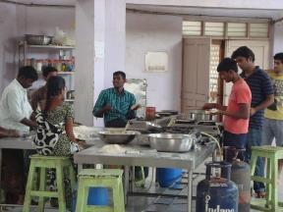
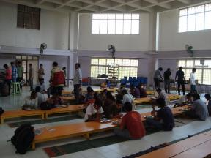
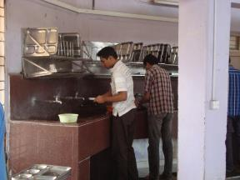
Example: Yuktahar Mess IIIT Hyd (yukta=appropriate, aahar=intake)
In June, 2005 a Yoga Workshop called Prakritistha was organized. The food (Yuktahar) offered in the workshop was liked by everyone and it was proposed to regularize such food. Henceforth in the month of February, 2006 a new mess system was started…
The idea was to provide simple healthy home food without too much of spices or oil with a home-like setting for the students to eat in. As the concept evolved, the students were encouraged to participate in the running of the Yuktahar. Many times, students accompanied Vinayak-ji (Yoga-Acharya ji) for purchasing raw materials. Students also helped in keeping the accounts. Slowly Yuktahar evolved into a co-operative mess.
The concept of Yuktahar also questioned some values of how one eats. At home, one is relaxed and in many Indian homes people eat by sitting on the floor. Hence, Yuktahar has low height chowkies & durries to ensure that students can eat this way.
  Simple and healthy food in a disciplined environment.
  Working in a cooperative and coordinated manner as if it is a community kitchen.
  Nurturing very basic habits like not wasting food,
  Behaving in a friendly manner with the workers, etc.
  Developing a sense of responsibilities and duties before demanding for rights.
In Yuktahar, many steps were taken to sensitize the students. Hence, the students would wash their own plates. It has developed a sense of dignity of labour. Once all the mess workers got infected with conjunctivitis. On sending mail to the student body regarding the situation, several students volunteered to cook chapatis and serve food. 10-15 students were working at any given time for a couple of days.

Slide 38
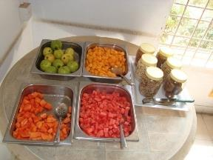
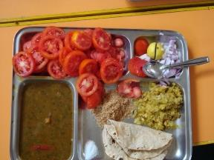
Example: Yuktahar Mess, IIIT Hyderabad
Goals of Yuktahar Kendra
  Self Reliance (swavalamban) and Self-Sufficiency (atmanirbharta), by reducing dependency on other means.
  Selfless service (nishkaam karma) through volunteering in at least one of the activities.
  Health and Hygienic food by means of Organic Food, Health Drinks, Sprouted seeds.
  Giving Platform for Local Production from unnoticed farmers.
  Providing access to traditional medicine as Ayurveda and Home-made solutions.
Wastage typically 30 kg/day (280 students) 110 gms/student/day
Wastage in OBH mess 85 Kg/day (350 students) 243 gms/stdent/day
Typical Breakfast Menu
  Soaked almonds (8), washed dates (8)
  Unlimited seasonal fruits, sprouts
  Unlimited ragi/other whole grain porridge (sweet)
  Unlimited suji/other whole grain upma/poha (salty)
  Unlimited warm milk
The monthly bill is calculated taking into account all the expenses and dividing by the number of students eating there. Transparency in the systems is maintained. At another level, the food is prepared in the same dining hall (transparently in open view) which ensures quality of food (indicative price breakfast is Rs. 30, lunch & dinner is Rs 40 each)
The people working full time as mess employees are paid well (min 8000
OBH min 3000)

Slide 39
Example
2-Acre Model

Slide 40
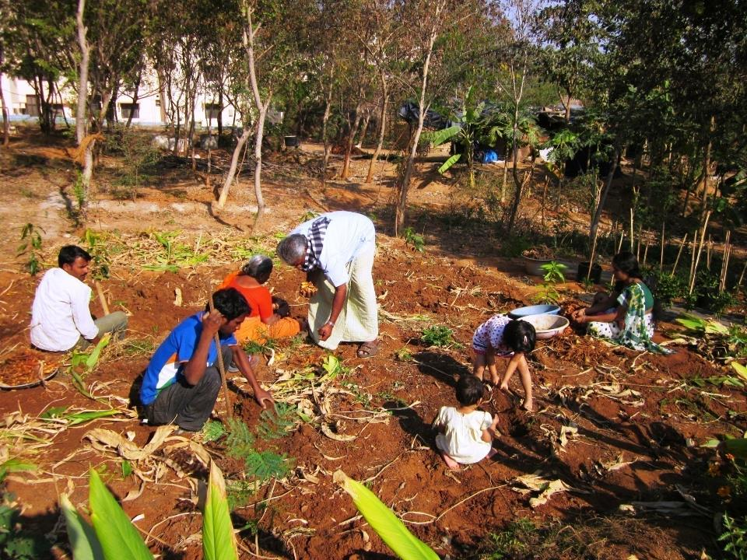
IIIT-H’s REFARM & TRANSFARM
G. Syamasundar Reddy

Slide 41
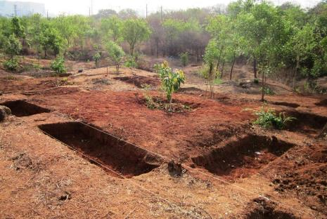
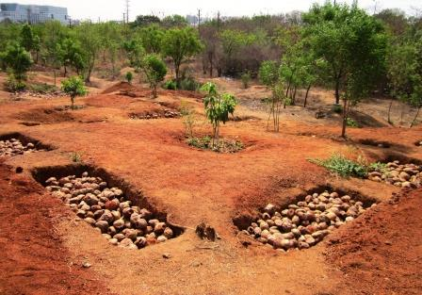
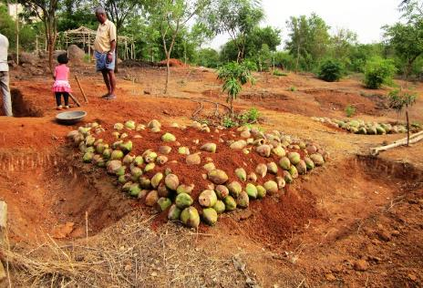
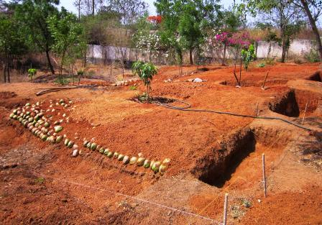
Soil and Water Conservation on Slopes

Slide 42
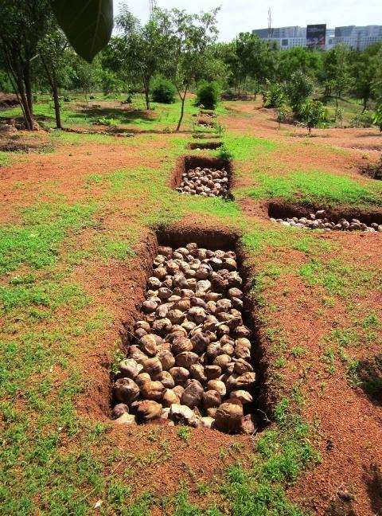
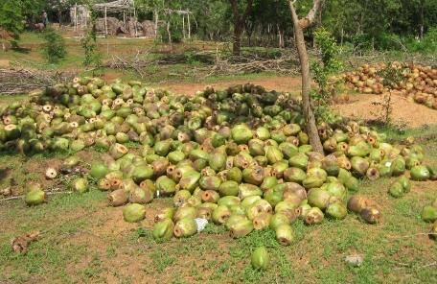
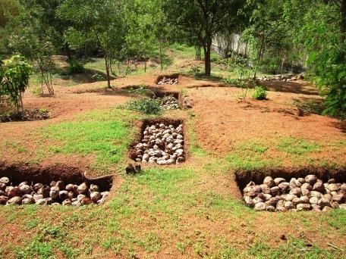
Soil and Water Conservation on Slopes

Slide 43
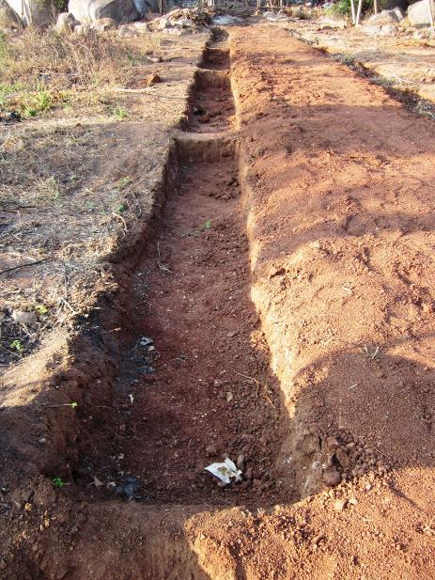
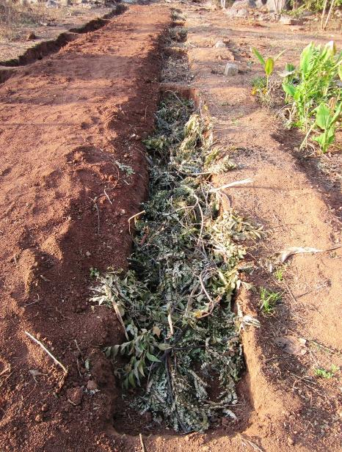
Soil and Water Conservation on Slopes

Slide 44
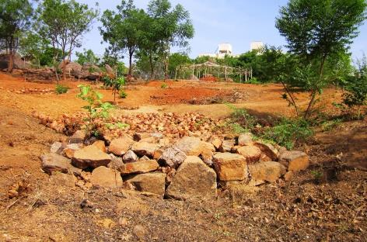
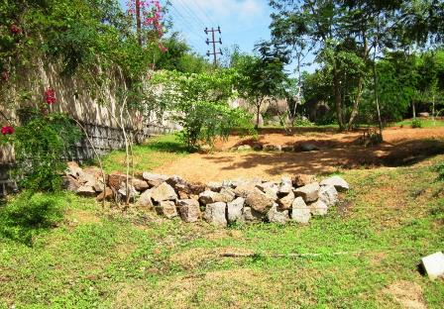
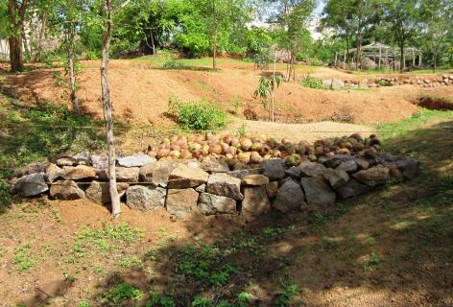
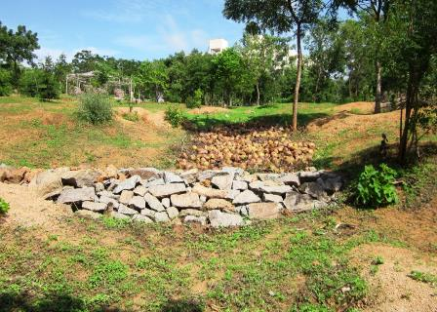
Soil and Water Conservation on Slopes

Slide 45
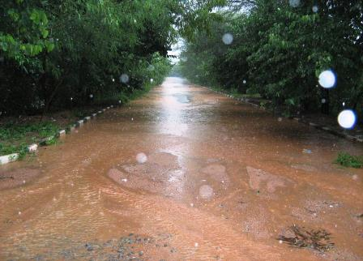
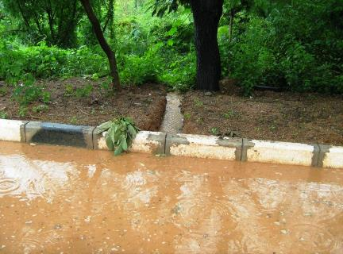
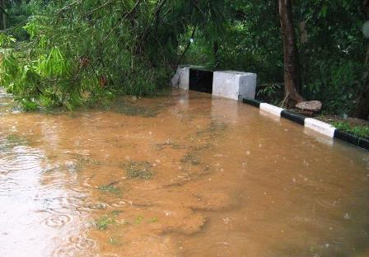
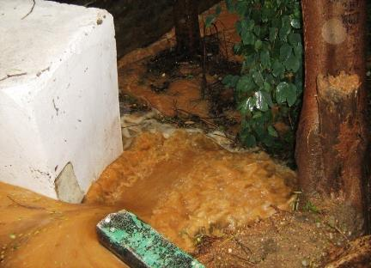
Rain Water Harvesting

Slide 46
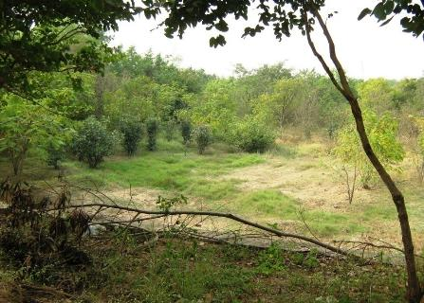
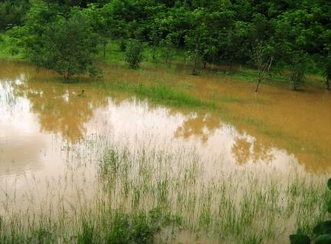
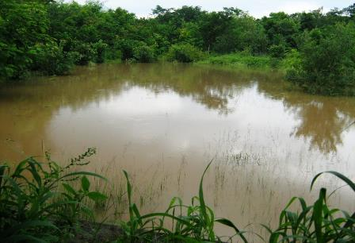
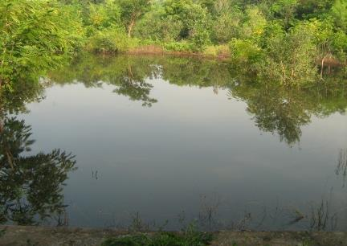
Rain Water Harvesting

Slide 47
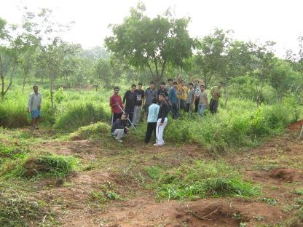
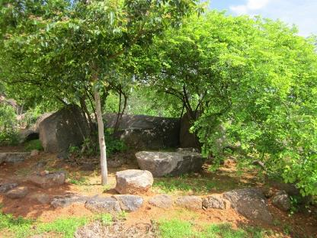
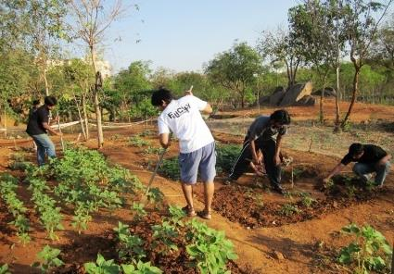
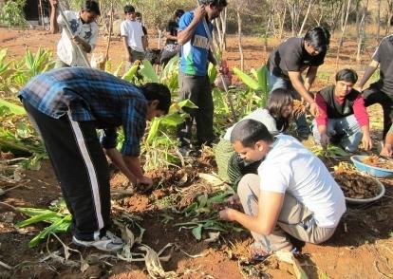
Principles & Practices of Natural Farming – Open Air Classroom

Slide 48
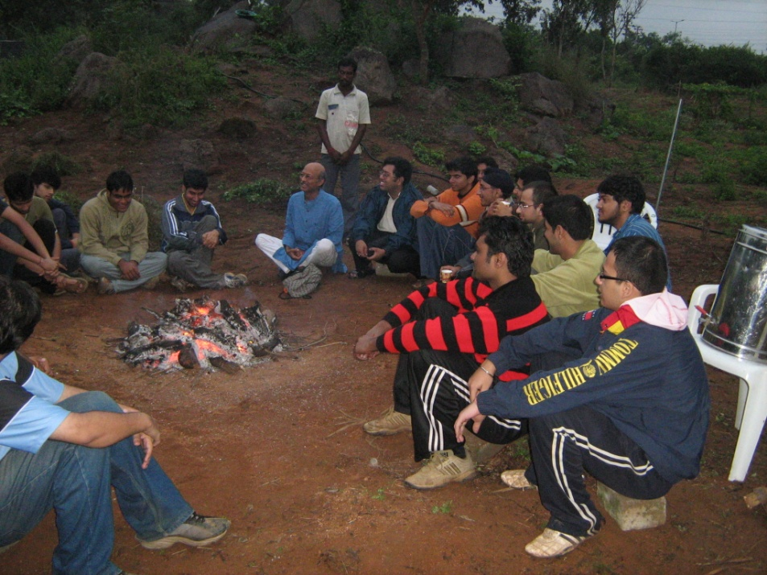
The role of Human Being is to realize this mutual fulfillment in Nature – For this, all that we need to do is:
  To understand that mutual fulfilment is inherent in nature – we do not have to create it
  To live accordingly – then the mutual fulfilment amongst the 4 orders will be realised (and there is every provision in nature for living in a mutually fulfilling manner)

Slide 49
5/ Projects in dimension 5-exchange-storage
Exchange – of physical facilities for mutual fulfillment (not with madness of profit)
Storage – of physical facilities for right utilization in the future (not with madness of profit / of accumulation)
Suggest how the supply chain for summer vegetables can be optimised to minimize distance & time between production and consumption for your college mess (the cost of transportation is a major component of the total cost of the food today) (dimension 5-exchange-storage, type 1-study)
Read the book “Small is Beautiful”, EF Schumacher (many useful books, documentaries etc. can be reviewed). Articulate your takeaway about role of understanding, relationship, economics & money in society (dimension 5-exchange-storage, type 1-study)
Watch the video “Food Inc.”. Articulate your takeaway about the 3 key lessons for our society, i.e. things to do or things to avoid doing (dimension 5-exchange-storage, type 1-study)

Slide 50
Social Internship
Some possible centers for up-to one month Social Internship in Punjab – for Teachers and Students are (Sample List):
  Kheti Virasat, Shri Anandpur Sahib
  Riarki College, Guruhargobindpur
  Pingalwara Trust, Sri Amritsar Sahib
  Nirmal Kutia, Sultanpur Lodhi
  Women Action for Ecology
The idea of internship is similar to projects, to observe what is and to share the observations in the form of a brief report

Slide 51
Detailed Goals for Social Projects/Internship
At the university level, we are focusing on providing guidelines and budget; collating the submissions and summarising them into something meaningful for the future
We are expecting the initiative of refining the ideas and of implementation from the HVPE teachers, the college VE Cell and the college NSS Cell

Slide 52
Active VE Cell in your College
#1 VE Cell has Responsible & Active Members
  members take the initiative to actively develop and maintain a conducive environment of trust that facilitates learning in the college
  members are ambassadors for human education, they are able to facilitate understanding for the top10 of the college management and administration (eg. facilitate their participation in VE activity... VE Workshop)
  members are personally involved in social projects, internship (Social organisations, NSS, CSR etc.)
  members support & participate in VE activity... VE Workshop
  members teach and/or conduct 1 day to 8 day workshop once/semester

Slide 53
Active VE Cell in your College
#2 Focus teacher & student activity on understanding
  facilitate preparation of teachers (how many teachers are capable of conducting 1 day wksp... 8 day wksp)
  facilitate regular meeting of students and mentors
  facilitate social projects, internship for teachers & students
  facilitate few relevant invited talks (say once in 2 months)

Slide 54
Program of Action for Teachers
Self -exploration , resolution , awareness & self-purification
- Learning & practice skills - development of competence
Daily:
Self Study
Recognising family need of PF
Production of more than what is required by own labour
Family education sanskar
Weekly:
Family Meeting
Justice in Human-Human relationship
Weekly:
Student Meeting
Faculty Meeting
- Participation in larger order, in at least one of the 5 dimensions with a view of mutual fulfilment
Right utilisation, protection, enrichment of physical facility
Right Understanding & Right Feelings
– All Encompassing Solution
Prosperity
– Feeling of having more than required physical facility
Fearlessness
(Trust)
– Clarity that the other intends my happiness
Co-Existence
– Clarity that existence is
co-existence

Slide 55
Gross Misunderstanding – Activity for Domination, Sensation…
Domination to be special, for sensation
Madness for consumption
Madness for profit (accumulation)
Madness for sensual pleasure
Undefined and changing need of money, physical facility
Obtaining money, physical facility by exploitation
Transferring assumptions in family, society
Expectations from other, family, society...
Domination, exploitation, misguiding others
Effort to secure oneself from others
Utilisation of physical facility for sensation, domination
Irresponsible, over-use of physical facility
Mastery over nature
Assumptions, Confusion
Feeling of opposition,
wretchedness, cunningness, cruelty (fojks?k] nhurk] ghurk] Øwjrk)
Deprivation – Feeling of not having enough money / physical facility
Fear, particularly from other human beings
Inhuman system
Resource depletion & pollution

